Slide 1

Essential Concepts in Generative AI
Understanding core concepts before getting started
Notes:
---
This presentation covers the fundamental concepts in generative AI, exploring core technologies and advanced topics. We will learn about hallucination, prompt engineering, embeddings, retrieval methods, agentic AI, and safety concerns to build a comprehensive understanding of this transformative technology.
Image source: Microsoft 365 content library

Slide 2
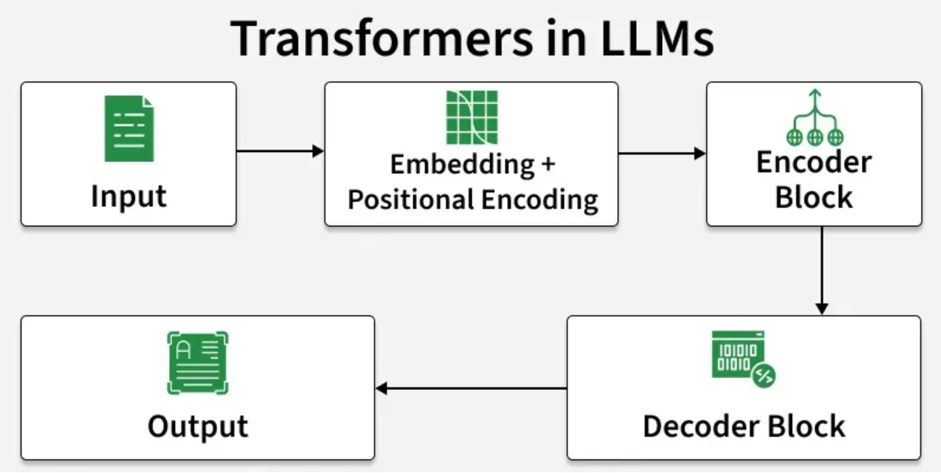
What is a large language model?
Large Language Models (LLMs) are advanced AI systems built on deep neural networks designed to process, understand and generate human-like text.
By using massive datasets and billions of parameters, LLMs have transformed the way humans interact with technology.
It learns patterns, grammar and context from text and can answer questions, write content, translate languages and many more.

Slide 3
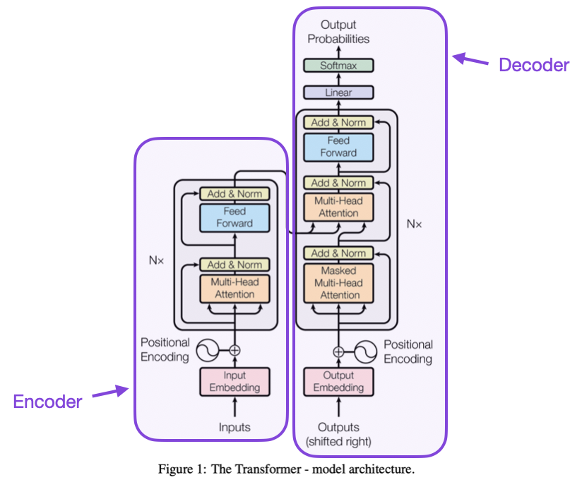
A Transformer is made up of two main parts:
Encoder → understands the input
Decoder → generates the output

Slide 4
Transformers architecture
Each part (Encoder/Decoder) has stacked layers, and every layer has:
1. Self-Attention Layer
Learns how each word relates to others in the same sentence
Uses Q (Query), K (Key), and V (Value) vectors to compute attention scores
Example: In “The cat sat on the mat,” the word “cat” will attend to “sat” and “mat”.
2. Feed-Forward Neural Network
After attention finds relationships, this small network learns deeper patterns.
Works independently on each word’s representation.
3. Add & Norm
Keeps training stable by adding the original input (residual connection)and normalizing values for consistency.

Slide 5
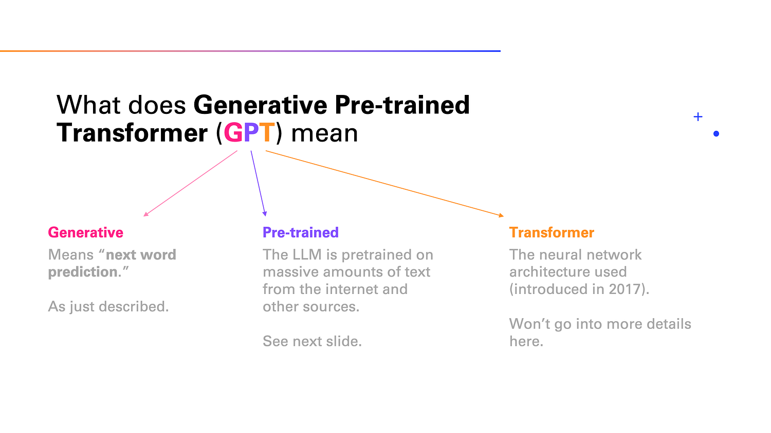
Notes:
https://medium.com/data-science-at-microsoft/how-large-language-models-work-91c362f5b78f

Slide 6




What We'll Cover
Core Concepts in Generative AI
Retrieval & Knowledge Augmentation Concepts
Agentic AI Concepts
Evaluation & Safety Concepts

Slide 7
Core Concepts in Generative AI
Notes:
---
This slide references information from the following file: https://michelingroup-my.sharepoint.com/personal/ankit_mirajkar_michelin_com/Documents/GenAI-Concepts-Guide.pdf
Hallucination: Definition, Examples, and Role in LLMs, Prompt Engineering: Techniques and Use Cases, Context Window: Capacity and Applications, Tokens, Temperature, and Learning Approaches

Slide 8
Hallucination

Slide 9

Hallucination
Definition of Hallucination
  Hallucination occurs when AI produces factually incorrect but plausible-sounding information.
Examples of Hallucination
  Examples include AI falsely reporting events or citing non-existent sources.
Role in Large Language Models
  LLMs generate text based on patterns, which can produce convincing but false content.
Notes:
---
This slide references information from the following file: https://michelingroup-my.sharepoint.com/personal/ankit_mirajkar_michelin_com/Documents/GenAI-Concepts-Guide.pdf
📝 Definition:
When AI generates false or misleading information that sounds plausible but is factually incorrect
💡 Example:
ChatGPT claiming a famous person died when they're still alive, or citing non-existent research papers
🧠 Role in LLMs:
LLMs predict next words based on patterns, not facts, so they can create convincing but false content
🎯 Use Case:
Medical diagnosis systems need hallucination detection to avoid giving dangerous health advice
Image source: Microsoft 365 content library

Slide 10
Prompt Engineering

Slide 11

Prompt Engineering
Definition of Prompt Engineering
  Prompt engineering is the art and science of crafting inputs to optimize AI model outputs effectively.
Importance in Language Models
  Large language models are highly sensitive to prompt phrasing, making good prompts essential for better results.
Practical Use Case
  Customer service chatbots utilize prompt engineering to deliver consistent and helpful responses to users.
Notes:
---
This slide references information from the following file: https://michelingroup-my.sharepoint.com/personal/ankit_mirajkar_michelin_com/Documents/GenAI-Concepts-Guide.pdf
📝 Definition:
The art and science of crafting inputs to get the best outputs from AI models
💡 Example:
Instead of 'Write about dogs,' use 'Write a 300-word informative article about dog training for new pet owners'
🧠 Role in LLMs:
LLMs are highly sensitive to how questions are phrased - better prompts = better results
🎯 Use Case:
Customer service chatbots use engineered prompts to provide consistent, helpful responses
Image source: Microsoft 365 content library

Slide 12
Context Window

Slide 13

Context Window
Context Window Definition
  The context window is the maximum text length an AI model can remember and analyze at once.
Role in Language Models
  Context window size determines how much conversation or document text an AI can process simultaneously.
Application in Legal Analysis
  Large context windows enable AI to analyze entire legal contracts effectively and accurately.
  Example
  GPT-4 can remember about 32,000 tokens (~24,000 words) of conversation history
Notes:
---
This slide references information from the following file: https://michelingroup-my.sharepoint.com/personal/ankit_mirajkar_michelin_com/Documents/GenAI-Concepts-Guide.pdf
📝 Definition:
The maximum amount of text an AI model can remember and consider at one time
💡 Example:
GPT-4 can remember about 32,000 tokens (~24,000 words) of conversation history
Overview
Core Concepts in Generative AI (8 concepts)
Retrieval & Knowledge Augmentation Concepts (6 concepts)
Agentic AI Concepts (3 concepts)
Evaluation & Safety Concepts (3 concepts)
Core Concepts in Generative AI
1. Hallucination
2. Prompt Engineering
3. Context Window
🧠 Role in LLMs:
Determines how much conversation history or document text the model can process together
🎯 Use Case:
Legal document analysis requires large context windows to understand entire contracts
Image source: Microsoft 365 content library

Slide 14
Token

Slide 15
Token
Definition
  The basic units that AI models use to process text - roughly 3-4 characters or parts of words
  Role in Language Models
  LLMs process and generate text token by token, affecting cost and processing speed
  Application in Legal Analysis
  API pricing is often based on token usage, so understanding tokens helps control costs
  Example
  The word 'artificial' might be split into tokens: 'art', 'ific', 'ial'
Notes:
---
This slide references information from the following file: https://michelingroup-my.sharepoint.com/personal/ankit_mirajkar_michelin_com/Documents/GenAI-Concepts-Guide.pdf
📝 Definition:
The maximum amount of text an AI model can remember and consider at one time
💡 Example:
GPT-4 can remember about 32,000 tokens (~24,000 words) of conversation history
Overview
Core Concepts in Generative AI (8 concepts)
Retrieval & Knowledge Augmentation Concepts (6 concepts)
Agentic AI Concepts (3 concepts)
Evaluation & Safety Concepts (3 concepts)
Core Concepts in Generative AI
1. Hallucination
2. Prompt Engineering
3. Context Window
🧠 Role in LLMs:
Determines how much conversation history or document text the model can process together
🎯 Use Case:
Legal document analysis requires large context windows to understand entire contracts
Image source: Microsoft 365 content library

Slide 16
Temperature

Slide 17
Temperature
Definition
  A setting that controls how creative or predictable AI responses are (0 = predictable, 2 = very creative)
  Examples of Hallucination
  Low temperature: 'The sky is blue.' High temperature: 'The sky resembles a sapphire canvas.’
  Role in Large Language Models
  Controls randomness in word selection - higher values increase diversity but may reduce accuracy
  Use Case in Medical Diagnosis
  Creative writing uses high temperature; factual reporting uses low temperature
Notes:
---
This slide references information from the following file: https://michelingroup-my.sharepoint.com/personal/ankit_mirajkar_michelin_com/Documents/GenAI-Concepts-Guide.pdf
📝 Definition:
When AI generates false or misleading information that sounds plausible but is factually incorrect
💡 Example:
ChatGPT claiming a famous person died when they're still alive, or citing non-existent research papers
🧠 Role in LLMs:
LLMs predict next words based on patterns, not facts, so they can create convincing but false content
🎯 Use Case:
Medical diagnosis systems need hallucination detection to avoid giving dangerous health advice
Image source: Microsoft 365 content library

Slide 18
Few-Shot /Zero-Shot /One-Shot Learning

Slide 19
Few-Shot / Zero-Shot / One-Shot Learning
Definition
  Teaching AI by providing examples: Zero (no examples), One-Shot (1 example), Few-Shot (multiple examples)
  Examples
  Zero-shot: 'Classify sentiment.' Few-shot: 'Happy=Positive, Sad=Negative. Now classify: Excited.’
  Role in Large Language Models
Allows models to perform new tasks without retraining by learning from examples in the prompt
  Use Case in Medical Diagnosis
  Email classification systems learn to categorize emails with just a few examples
Notes:
---
This slide references information from the following file: https://michelingroup-my.sharepoint.com/personal/ankit_mirajkar_michelin_com/Documents/GenAI-Concepts-Guide.pdf
📝 Definition:
When AI generates false or misleading information that sounds plausible but is factually incorrect
💡 Example:
ChatGPT claiming a famous person died when they're still alive, or citing non-existent research papers
🧠 Role in LLMs:
LLMs predict next words based on patterns, not facts, so they can create convincing but false content
🎯 Use Case:
Medical diagnosis systems need hallucination detection to avoid giving dangerous health advice
Image source: Microsoft 365 content library

Slide 20
Embeddings and Chain of Thought Reasoning
Notes:
---
This slide references information from the following file: https://michelingroup-my.sharepoint.com/personal/ankit_mirajkar_michelin_com/Documents/GenAI-Concepts-Guide.pdf
Embeddings: Mathematical Representation and Use Cases, Chain of Thought (CoT): Step-by-Step Reasoning

Slide 21
Embeddings

Slide 22

Embeddings
Definition of Embeddings
  Embeddings are numerical representations of words capturing their meanings in vector form.
Semantic Similarity Example
  Words like 'king' and 'queen' have similar embeddings, showing related meanings, unlike 'king' and 'banana'.
Role in Large Language Models
  Embeddings enable LLMs to understand concept relationships and perform semantic searches effectively.
Practical Use Cases
  Recommendation systems use embeddings to suggest products or content based on similarity and relevance.
Notes:
---
This slide references information from the following file: https://michelingroup-my.sharepoint.com/personal/ankit_mirajkar_michelin_com/Documents/GenAI-Concepts-Guide.pdf
📝 Definition:
Mathematical representations of words or concepts as lists of numbers that capture meaning
💡 Example:
Words like 'king' and 'queen' have similar embeddings, while 'king' and 'banana' are very different
🧠 Role in LLMs:
Enable models to understand relationships between concepts and perform semantic search
🎯 Use Case:
Recommendation systems use embeddings to suggest similar products or content
Image source: Microsoft 365 content library

Slide 23
Chain of thought

Slide 24
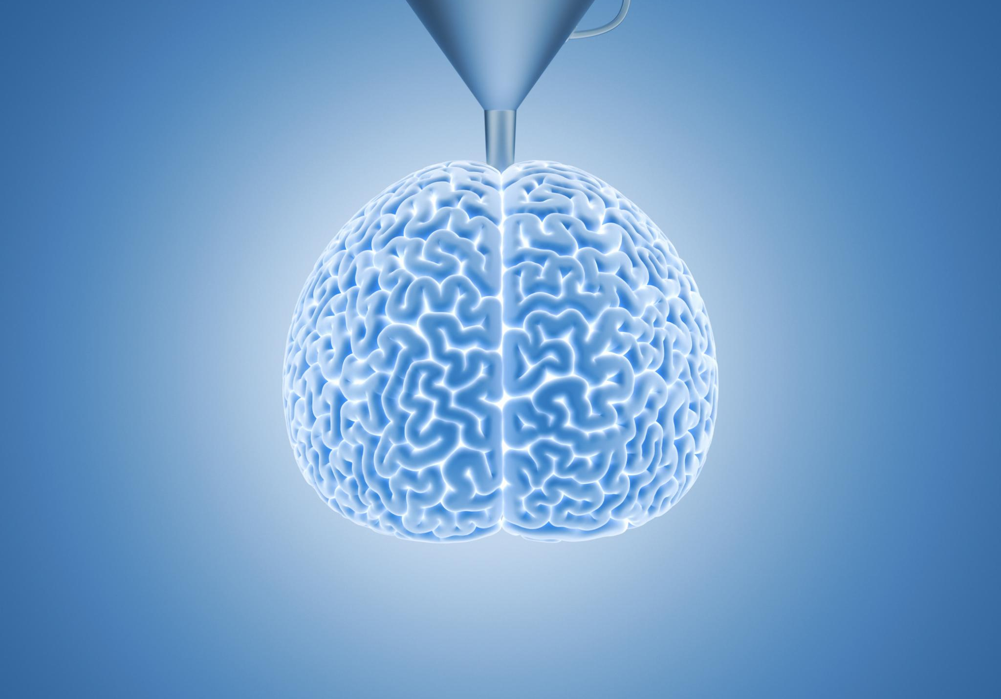
Chain of Thought (CoT): Step-by-Step Reasoning
Definition of CoT
  Chain of Thought is a method where AI describes its reasoning steps to improve answer clarity.
Example Explanation
  Instead of just answering '15,' the AI shows: '5 apples + 3 apples = 8 apples, then 8 + 7 = 15 apples total’
  Role in Large Language Models
  CoT enhances accuracy in complex problems by making AI's reasoning explicit and transparent.
Educational Use Cases
  Math tutoring apps use CoT to support students in understanding problem-solving steps effectively.
Notes:
---
This slide references information from the following file: https://michelingroup-my.sharepoint.com/personal/ankit_mirajkar_michelin_com/Documents/GenAI-Concepts-Guide.pdf
📝 Definition:
A technique where AI explains its reasoning step-by-step to arrive at better answers
💡 Example:
Instead of just answering '15,' the AI shows: '5 apples + 3 apples = 8 apples, then 8 + 7 = 15 apples total'
🧠 Role in LLMs:
Improves accuracy on complex problems by making the reasoning process explicit
🎯 Use Case:
Math tutoring applications use CoT to help students understand problem-solving steps
Image source: Microsoft 365 content library

Slide 25
Retrieval & Knowledge Augmentation Concepts
Notes:
---
This slide references information from the following file: https://michelingroup-my.sharepoint.com/personal/ankit_mirajkar_michelin_com/Documents/GenAI-Concepts-Guide.pdf
Grounding: Connecting AI to Real Information, Retrieval-Augmented Generation (RAG): Search and Response Generation, Vector Databases: Semantic Search and Applications, Chunking: Document Processing for AI, Reranking: Improving Search Result Relevance, Hybrid Search: Combining Search Methods

Slide 26
Grounding

Slide 27

Grounding: Connecting AI to Real Information
Definition of Grounding
  Grounding connects AI responses to real, verifiable information sources to reduce hallucinations.
Example Application
  Instead of guessing stock prices, AI retrieves current market data before responding.
Role in Large Language Models
  Grounding anchors model outputs to factual sources beyond the training data.
Practical Use Case
  News summarization systems ground articles in verified sources to enhance accuracy.
Notes:
---
This slide references information from the following file: https://michelingroup-my.sharepoint.com/personal/ankit_mirajkar_michelin_com/Documents/GenAI-Concepts-Guide.pdf
📝 Definition:
Connecting AI responses to real, verifiable information sources to reduce hallucinations
💡 Example:
Instead of guessing stock prices, the AI looks up current market data before responding
🧠 Role in LLMs:
Anchors model outputs to factual sources rather than relying solely on training data
🎯 Use Case:
News summarization systems ground articles in verified sources for accuracy
Image source: Microsoft 365 content library

Slide 28
RAG

Slide 29

Retrieval-Augmented Generation (RAG): Search and Response Generation
Definition of RAG
  RAG is a method where AI searches relevant information before generating informed responses.
Practical Example
  RAG searches employee handbook to answer company policy questions accurately.
Role in Language Models
  RAG integrates language model capabilities with real-time external knowledge access.
Customer Support Use Case
  Customer support uses RAG to deliver precise, up-to-date product information.
Notes:
---
This slide references information from the following file: https://michelingroup-my.sharepoint.com/personal/ankit_mirajkar_michelin_com/Documents/GenAI-Concepts-Guide.pdf
📝 Definition:
A method where AI first searches for relevant information, then uses it to generate responses
💡 Example:
When asked about company policies, RAG first searches the employee handbook, then answers based on findings
🧠 Role in LLMs:
Combines the model's language abilities with real-time access to external knowledge
🎯 Use Case:
Customer support systems use RAG to provide accurate, up-to-date product information
Image source: Microsoft 365 content library

Slide 30
Vector DB

Slide 31

Vector Databases: Semantic Search and Applications
Definition of Vector Databases
  Vector databases store and search data based on semantic similarity instead of exact keyword matches.
Example of Semantic Search
  Searching 'car problems' retrieves related documents about vehicle and automotive issues by meaning.
Role in Large Language Models
  Vector databases enable LLMs to understand context and meaning, improving semantic search capabilities.
Applications in E-Commerce
  E-commerce platforms use vector databases for smarter product search and personalized recommendations.
Notes:
---
This slide references information from the following file: https://michelingroup-my.sharepoint.com/personal/ankit_mirajkar_michelin_com/Documents/GenAI-Concepts-Guide.pdf
📝 Definition:
Specialized databases that store and search information based on meaning similarity rather than exact matches
💡 Example:
Searching for 'car problems' also finds documents about 'vehicle issues' and 'automotive troubles'
🧠 Role in LLMs:
Enable semantic search capabilities that understand context and meaning, not just keywords
🎯 Use Case:
E-commerce platforms use vector databases for intelligent product search and recommendations
Image source: Microsoft 365 content library

Slide 32
Chunking

Slide 33

Chunking: Document Processing for AI
Concept of Chunking
  Chunking breaks large documents into smaller, manageable pieces for efficient AI processing.
Example of Document Sections
  A long manual is divided into sections such as Installation, Setup, and Troubleshooting for clarity.
Role in Large Language Models
  Chunking enables models to handle documents exceeding their context window size effectively.
Practical Use Case
  Legal research systems use chunking to quickly locate relevant clauses in lengthy contracts.
Notes:
---
This slide references information from the following file: https://michelingroup-my.sharepoint.com/personal/ankit_mirajkar_michelin_com/Documents/GenAI-Concepts-Guide.pdf
📝 Definition:
Breaking down large documents into smaller, manageable pieces for AI processing
💡 Example:
A 100-page manual is split into sections like 'Installation,' 'Setup,' 'Troubleshooting'
🧠 Role in LLMs:
Allows models to process documents that exceed their context window limits
🎯 Use Case:
Legal research systems chunk long contracts to find relevant clauses quickly
Image source: Microsoft 365 content library

Slide 34
Reranking

Slide 35
Reranking: Improving Search Result Relevance
Definition of Reranking
Reranking reorders search results to prioritize the most relevant information at the top.
Role in Language Models
Reranking enhances the input quality for language models, improving their response accuracy.
Practical Use Case
Research assistants use reranking to highlight the most relevant academic papers effectively.
Notes:
---
This slide references information from the following file: https://michelingroup-my.sharepoint.com/personal/ankit_mirajkar_michelin_com/Documents/GenAI-Concepts-Guide.pdf
📝 Definition:
Reordering search results to put the most relevant information first
💡 Example:
Initial search returns 20 results; reranking moves the 3 most relevant to the top
2. RAG (Retrieval-Augmented Generation)
3. Vector Databases
4. Chunking
5. Reranking
🧠 Role in LLMs:
Improves the quality of information fed to language models for better responses
🎯 Use Case:
Research assistants use reranking to prioritize the most relevant academic papers
Image source: Microsoft 365 content library

Slide 36
Evaluation & Safety Concepts
Notes:
---
This slide references information from the following file: https://michelingroup-my.sharepoint.com/personal/ankit_mirajkar_michelin_com/Documents/GenAI-Concepts-Guide.pdf
Bias: Fairness and Detection in AI Systems, Guardrails: Safety Measures and Responsible AI, Explainability: Understanding AI Decisions

Slide 37
Bias

Slide 38

Bias: Fairness and Detection in AI Systems
Unfair Treatment in AI
  AI systems can embed prejudices, leading to unfair treatment of certain groups in decisions like hiring.
Bias in Language Models
  Large language models may perpetuate societal biases present in their training data, impacting fairness of outputs.
Bias Detection in Use Cases
  Content moderation systems require bias detection mechanisms to ensure fair treatment of all users.
Notes:
---
This slide references information from the following file: https://michelingroup-my.sharepoint.com/personal/ankit_mirajkar_michelin_com/Documents/GenAI-Concepts-Guide.pdf
Unfair or prejudiced treatment of certain groups embedded in AI systems
💡 Example:
A hiring AI that unfairly rejects resumes with female names or certain ethnic backgrounds
🧠 Role in LLMs:
Can perpetuate societal biases present in training data, affecting fairness of outputs
🎯 Use Case:
Content moderation systems need bias detection to ensure fair treatment across all users
Image source: Microsoft 365 content library

Slide 39
Guardrails

Slide 40

Guardrails: Safety Measures and Responsible AI
Definition of Guardrails
  Guardrails are safety measures preventing AI from producing harmful or inappropriate content.
Examples of Guardrails
  Guardrails block AI from generating dangerous instructions or sharing personal information.
Role in Large Language Models
  Guardrails ensure responsible AI behavior and prevent misuse during deployment.
Use Case in Education
  Educational AI uses guardrails to keep content appropriate for different age groups.
Notes:
---
This slide references information from the following file: https://michelingroup-my.sharepoint.com/personal/ankit_mirajkar_michelin_com/Documents/GenAI-Concepts-Guide.pdf
📝 Definition:
Safety measures and rules that prevent AI systems from producing harmful or inappropriate content
💡 Example:
Blocking AI from generating instructions for dangerous activities or sharing personal information
🧠 Role in LLMs:
Essential for safe deployment by preventing misuse and ensuring responsible behavior
🎯 Use Case:
Educational AI tools use guardrails to ensure content is appropriate for different age groups
Image source: Microsoft 365 content library

Slide 41
Explainability

Slide 42
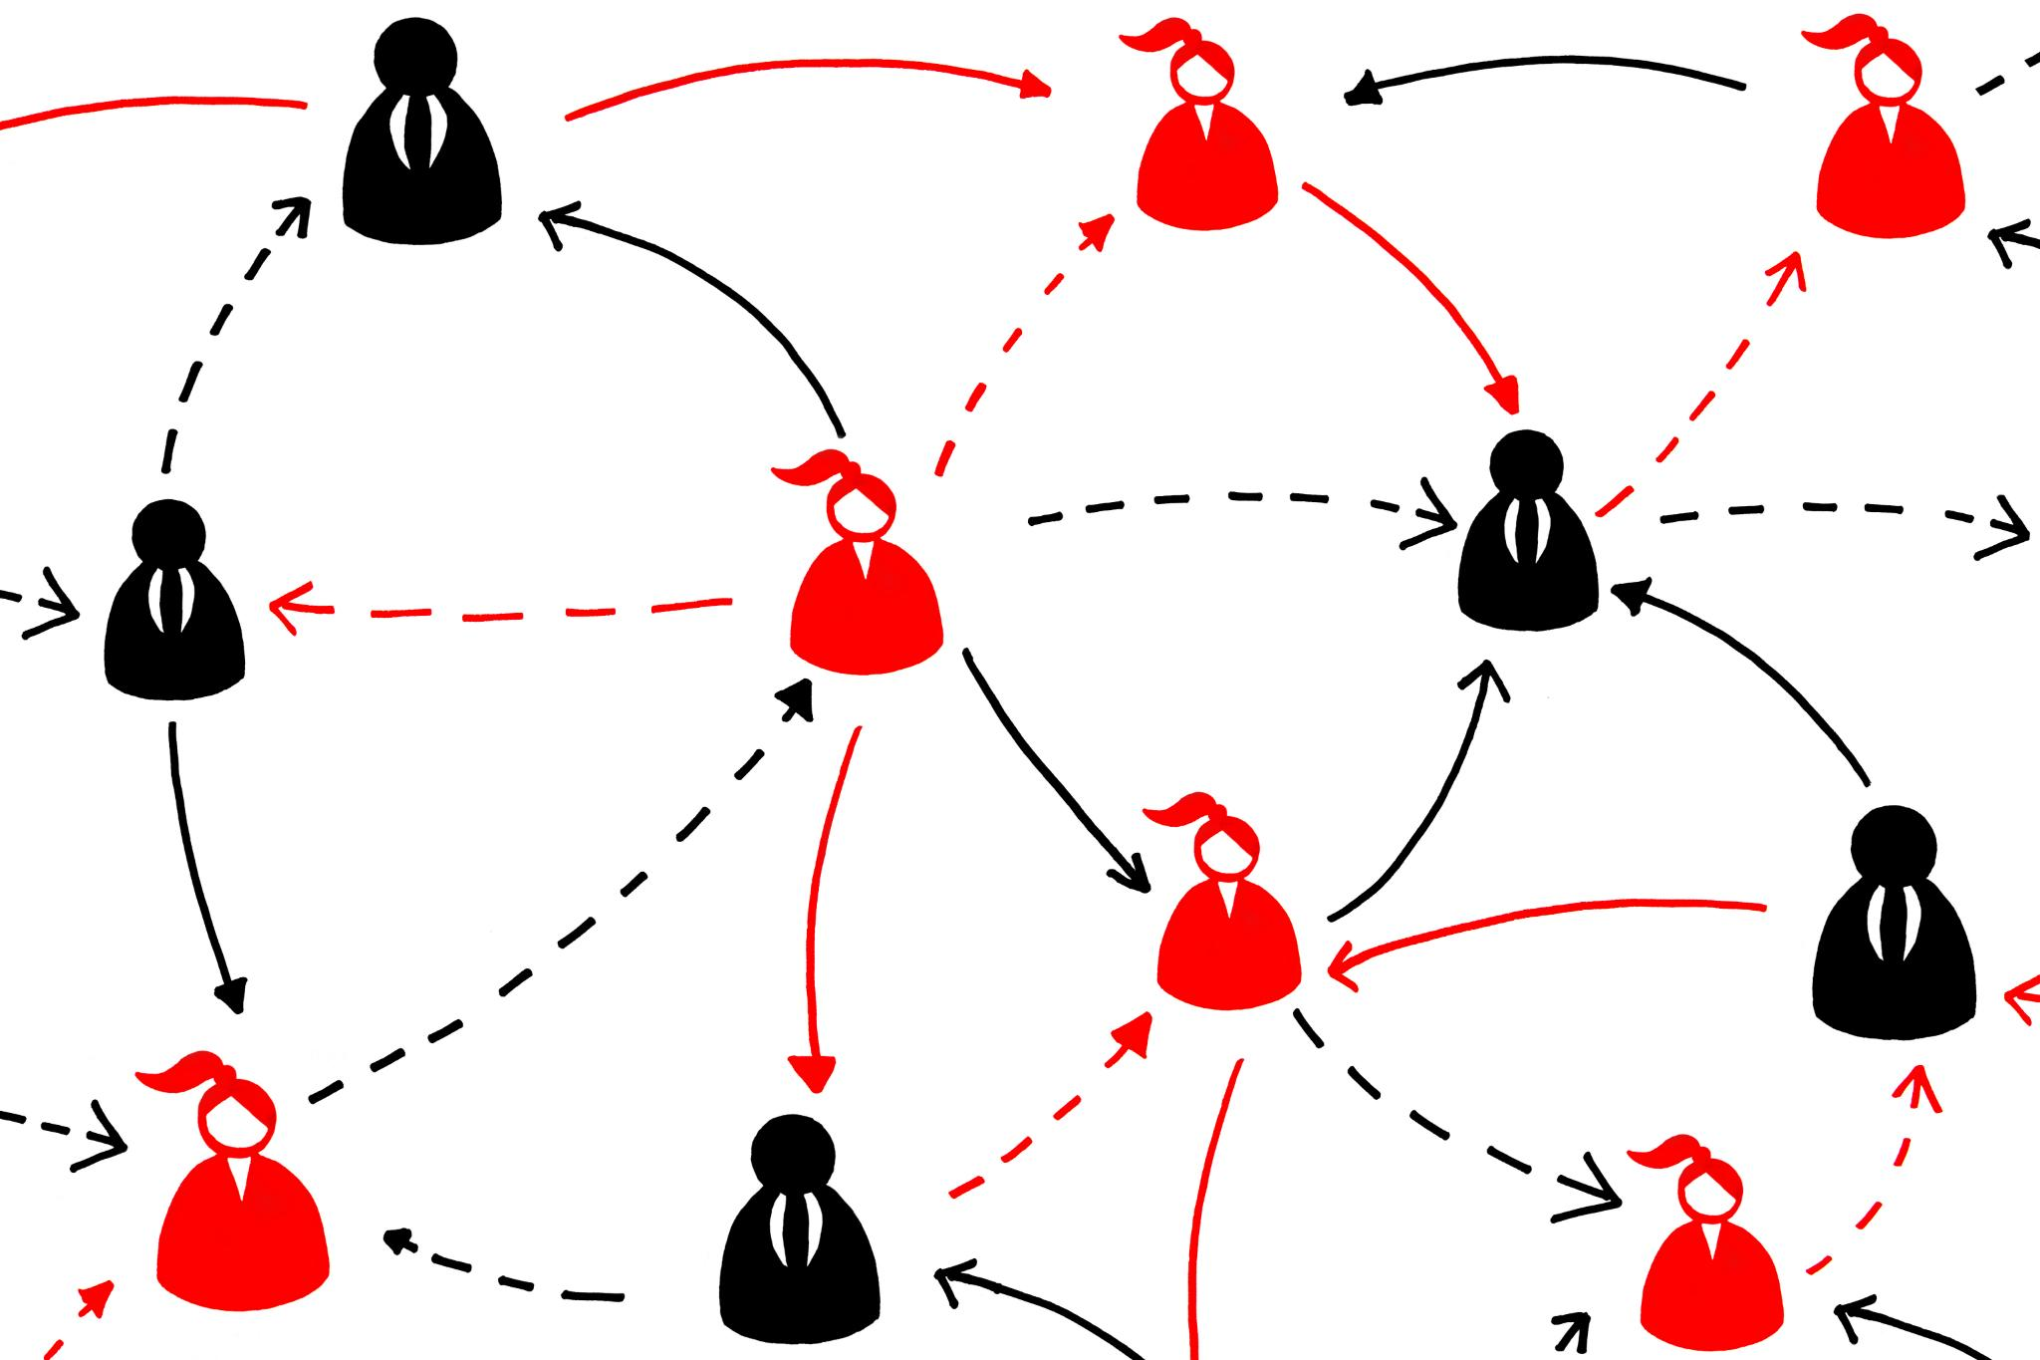
Explainability: Understanding AI Decisions
Definition of Explainability
  Explainability is the ability to understand and clearly explain how an AI system reaches a decision.
Example of AI Explanation
  A loan system explains approvals based on factors like credit score, income, and debt ratio percentages.
Role in Large Language Models
  Explainability is crucial for trust and accountability in high-stakes AI decisions, especially in LLMs.
Healthcare Use Case
  AI systems in healthcare must explain diagnoses to doctors, ensuring validation and building trust.
Notes:
---
This slide references information from the following file: https://michelingroup-my.sharepoint.com/personal/ankit_mirajkar_michelin_com/Documents/GenAI-Concepts-Guide.pdf
📝 Definition:
The ability to understand and explain how an AI system made a particular decision
💡 Example:
A loan approval system explaining: 'Approved based on credit score (40%), income (35%), debt ratio (25%)'
🧠 Role in LLMs:
Crucial for trust and accountability, especially in high-stakes decisions
🎯 Use Case:
Healthcare AI systems must explain diagnoses to doctors for validation and trust
These 20 essential concepts form the foundation of understanding Generative AI systems. From core technical concepts like tokens and embeddings to advanced applications like multi-agent systems and safety considerations, each plays a crucial role in the development and deployment of modern AI systems. Understanding these concepts enables better:
As the field continues to evolve rapidly, these fundamental concepts provide a solid foundation for further learning and practical application in the exciting world of Generative AI.
Image source: Microsoft 365 content library

Slide 43

Conclusion
Generative AI Scope
Generative AI includes foundational principles and advanced techniques across multiple domains.
Importance of Understanding
Grasping AI essentials is crucial for developing effective and responsible AI applications.
And the glossary is endless: Link to stay updated
Notes:
Generative AI encompasses a broad range of concepts from foundational principles to advanced techniques. Understanding these essentials enables the effective development and responsible application of AI technologies.

